Slide 1

New words
Badgers team

Slide 2

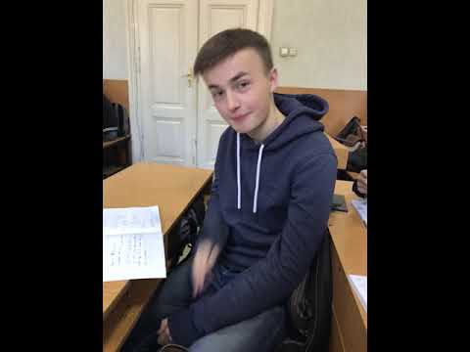

Our team
DMYTRO
DIANA
DMYTRO

Slide 3
description
The WPF application has two modes - add a topic and cards to it and learn words. Add a word to the card on one side and an explanation of the word on the other. When studying randomly show the card, when you click it returns to the other side - the explanation. If the word is not guessed - added again. Data is stored in the database.

Slide 4

the purpose of the application
To help people to learn new words by repeating them

Slide 5

user types
People who want to learn English with different levels

Slide 6




application requirements
As a girl from the forest I can click on a word to see its translation
As a program user I can switch mode to add new subject or new word
As a user I can revisit the word to learn it

Slide 7


SIMILAR programs
"English language" paper cards
MEMRISE

Slide 8
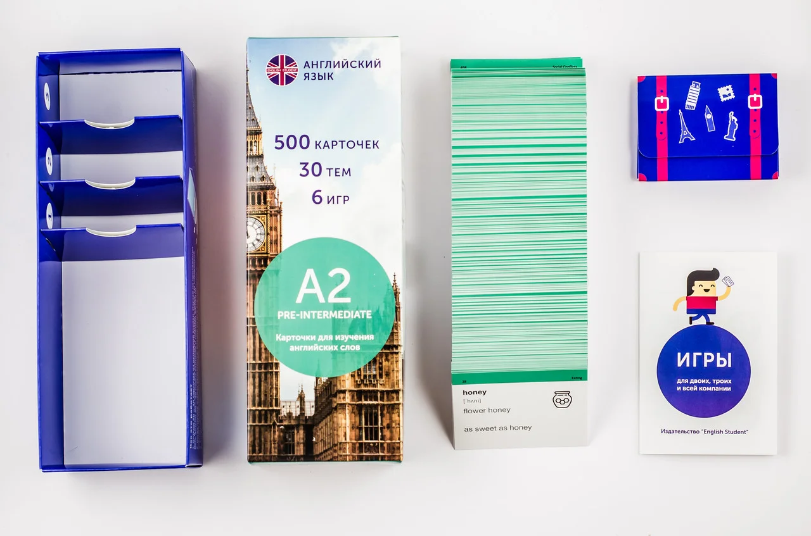
"English language" paper cards
+
specific topics
by levels
-
paper, take place
narrow circle of users

Slide 9

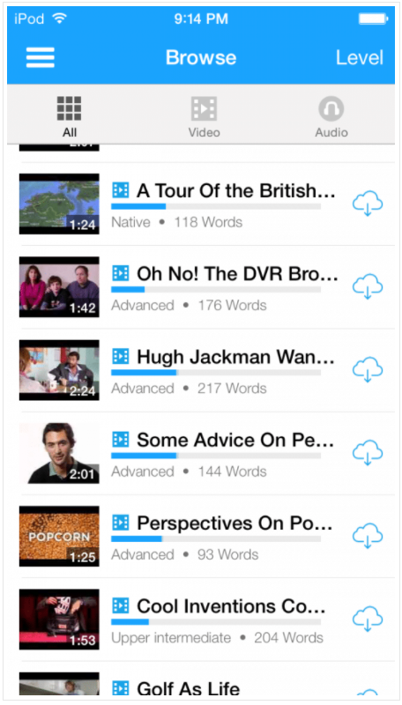
FluentU
We won't take
Mode to learn phrases
videos of the words in use
We will take

Slide 10

Will use
allow people to contribute their own additions to the flashcards
Won't use
a quiz-like setup
has regular reminders of old words
the app has the inability to create your own word lists
Btw

Slide 11



